Slide 1
SQL-PROJECT

Slide 2
APPLICATION
MySQL Workbench provides a visual console to easily administer MySQL environments and gain better visibility into databases.
MySQL is a relational database that uses structured query language.

Slide 3
Database
MySQL is a relational database management system (RDBMS) developed by Oracle that is based on structured query language (SQL). A database is a structured collection of data.
In this project, created database SQL_PROJECT

Slide 4
Data set
1. customer income status
2. loan status
3. customer info
4. country state
5. region info

Slide 5
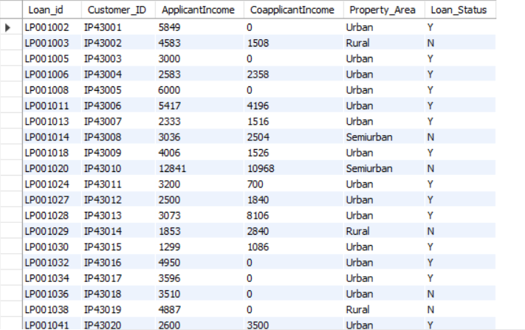
IMPORT
Sheet 1-customer income status
Import table from sheet 1- customer income status
OUTPUT-

Slide 6
OUTPUT-
614 RECORDS IMPORTED IN THE TABLE CUSTOMER_INCOME_STATUS

Slide 7
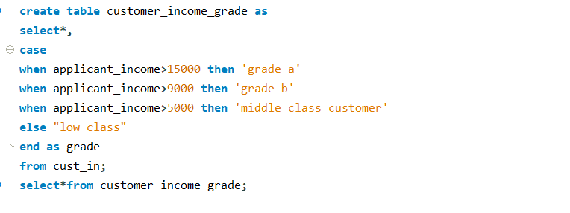
CRITERIA
Set customer criteria based on applicant income-
Criteria-1
Applicant income >15,000 = grade a
Applicant income >9,000 = grade b
Applicant income >5000 = middle class customer
Otherwise low class
(Create this as new table)

Slide 8
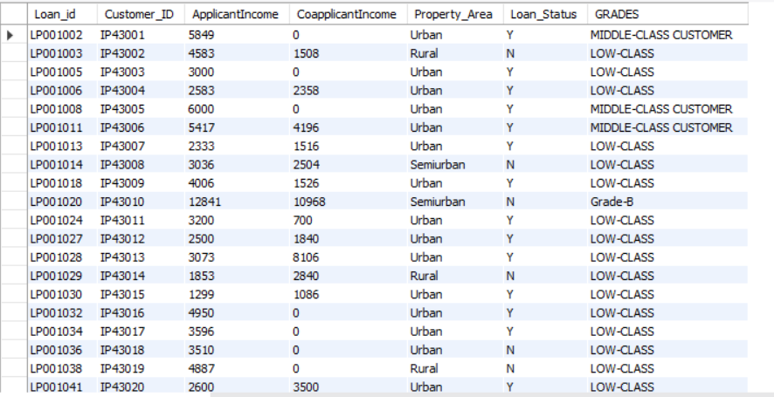
OUTPUT-GRADES
CUSTOMER_INCOME_GRADES TABLE CREATED

Slide 9
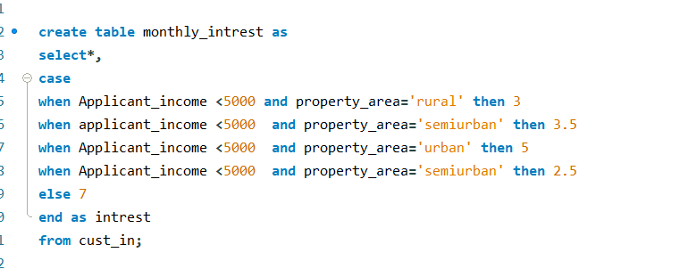
CRITERIA
Monthly interest percentage on the customer_income_grade table which is newly created
Criteria-2
Applicant income <5000 rural=3%
Applicant income <5000 semi rural=3.5%
Applicant income <5000 urban=5%
Applicant income <5000 semi urban= 2.5%
Otherwise =7%

Slide 10
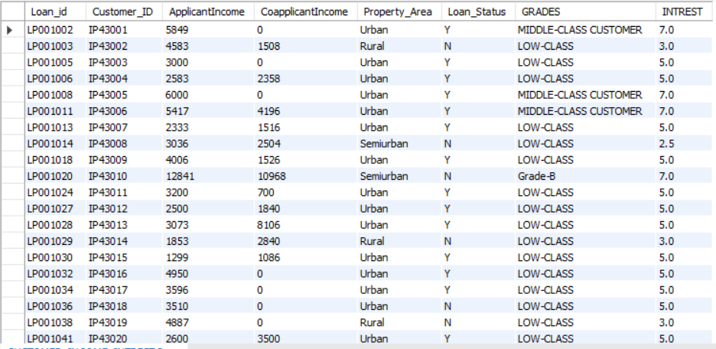
OUTPUT-INTREST
CUSTOMER_INCOME_INTREST TABLE CREATED

Slide 11
IMPORT
Import Sheet 2 - loan status
For adding triggers the loan status table should be created in MYSQL, because this row level trigger check while inserting the values in the table
OUTPUT-TABLE LOAN_STATUS CREATED-

Slide 12
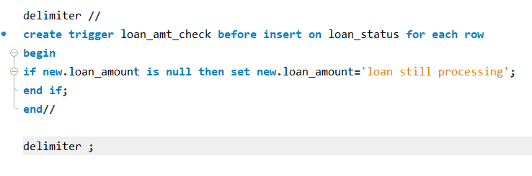
CRITERIA
Criteria-Adding row level trigger to check the loan amount ,when the amount is null- the trigger is set to update ‘loan still processing’
Loan amt null = loan still processing

Slide 13
CRITERIA
Create statement level trigger for cibil score-
For Cibil score same as loan status, creating table cibil_status for statement level triggers to be applied.
Here the cibil status is calculated based on the cibil score in the loan_status table.
OUTPUT-TABLE CIBIL_STATUS CREATED-

Slide 14
CRITERIA
Criteria for the statement level trigger to check the Cibil score-
Cibil score >900 high cibil score
Cibil score >750 no penalty
Cibil score >250 penalty customers
Cibil score <=0 reject customers (loan cannot apply)

Slide 15
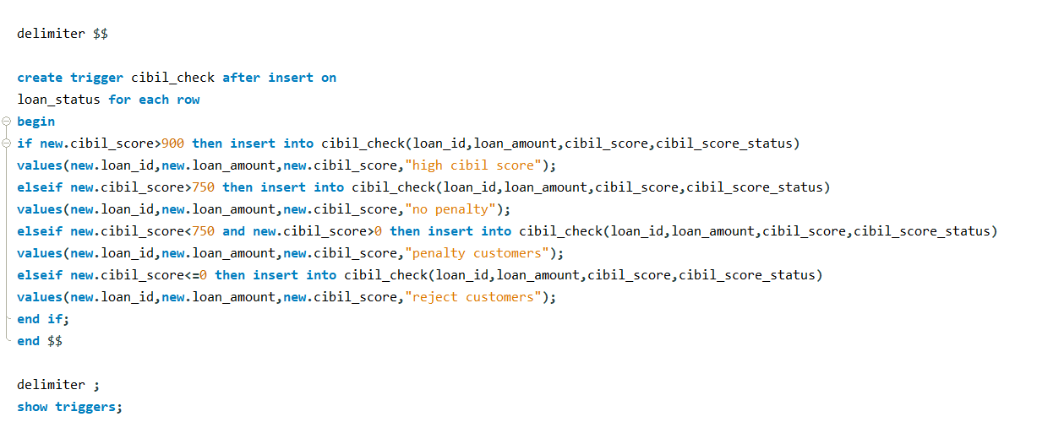
Statement level trigger

Slide 16
output
Cibil check trigger is set and the values are inserted in the table Loan_status.
Then automatically both the criteria for loan_status and cibil status gets updated.

Slide 17
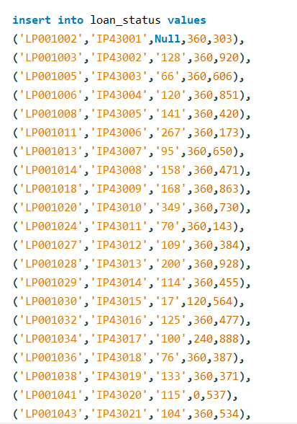
Insert-loan_status
These values are concatenated in excel and inserted in the workbench.
There are totally 614 records inserted

Slide 18
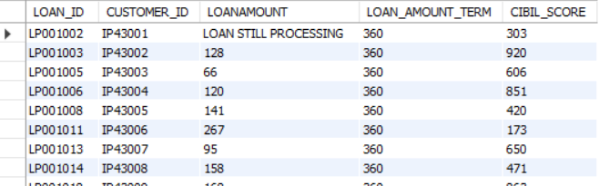
Triggers-output
Loan_status- where the null values are automatically updated with ‘LOAN STILL PROCESSING’

Slide 19
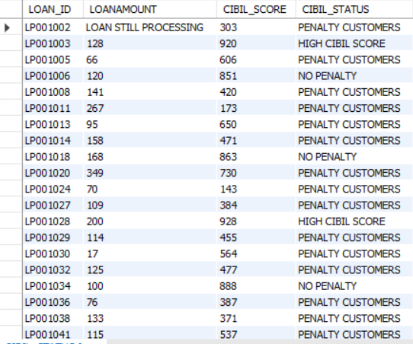
Triggers-output
Cibil_status- where the Cibil_status are automatically updated based on the criteria

Slide 20
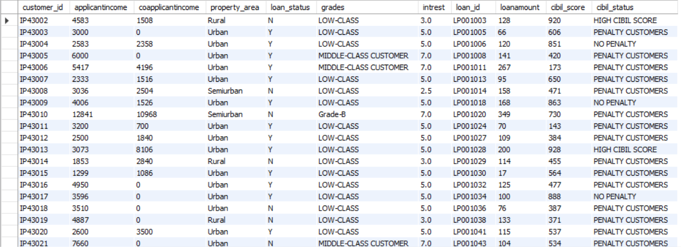
Join tables
Create all the above fields as a table-LOAN_CIBIL_SCORE_STATUS _DETAILS

Slide 21
UPDATE-TABLE
Then delete the reject and loan still processing customers
Update loan as integers

Slide 22
NEW FIELD CREATION
New field creation based on interest
Calculate monthly interest amt and annual interest amt based on loan amount
Create all the above fields as a table

Slide 23
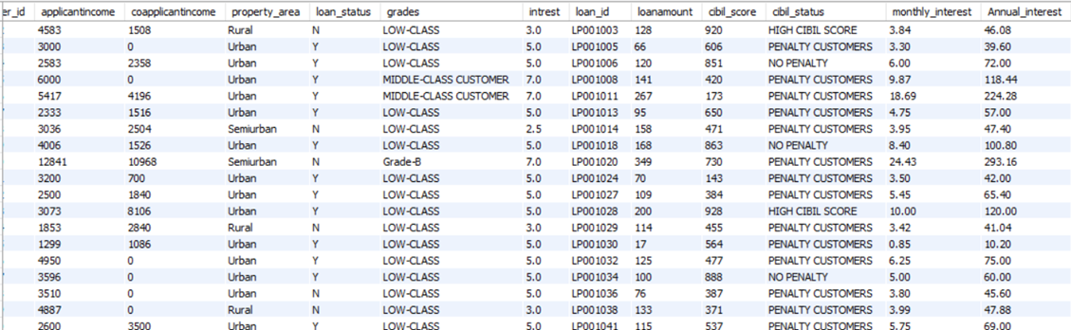
NEW FIELD CREATION
Table name - customer interest analysis

Slide 24
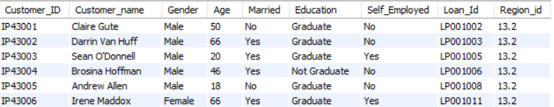
Import
Sheet 3 - customer info
*Import the table customer info

Slide 25
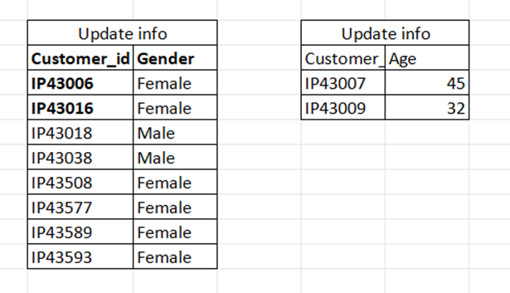
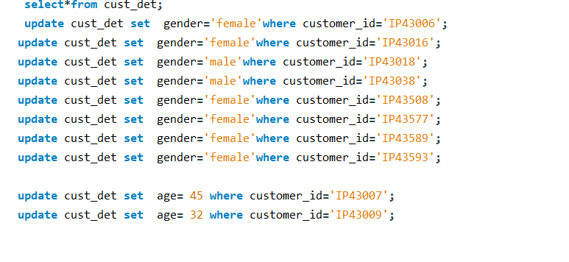
Update-customer table
Update gender and age based on customer id

Slide 26
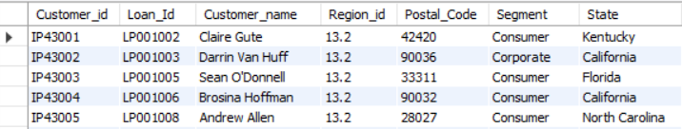
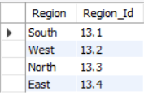
Import
Sheet 4 and 5- country state and region
Import the tables country_state and region_info
country_state table-
region_info table-

Slide 27
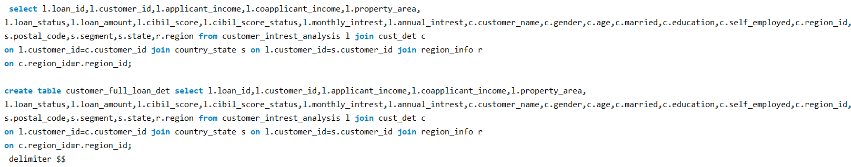
OUTPUT-1
Join all the tables without repeating the fields-
Joining all the tables-customer_interest_analysis, customer_det, country_state,region_info
customer_id | applicantincome | coapplicantincome | property_area | loan_status | grades | intrest | loan_id | loanamount | cibil_score | cibil_status | monthly_interest | annual_interest | customer_name | gender | age | married | education | self_employed | postal_code | segment | state | region | region_id

Slide 28

Output-2
Finding the mismatch details using joins-

Slide 29
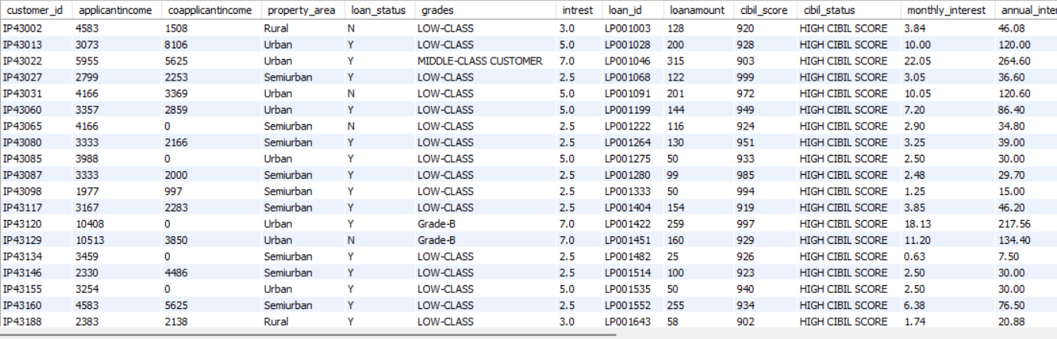
Output-3
Filtering information using inner join
Filtering high cibil score-

Slide 30
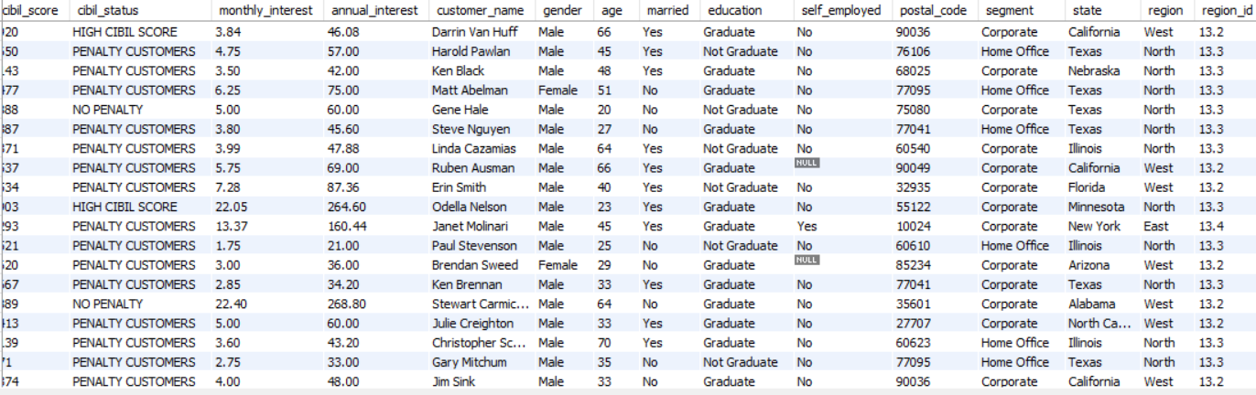
Output-4
Filter home office and corporate-

Slide 31
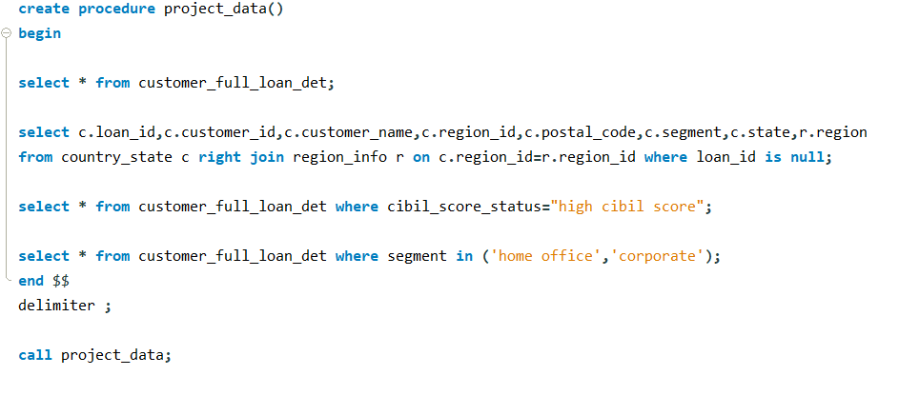
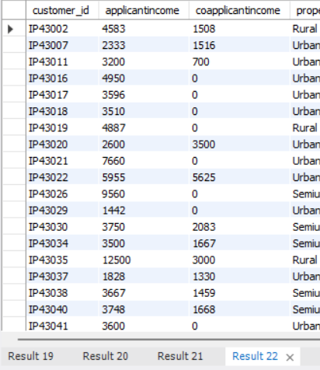
Output-5
Storing all the outputs as procedure-
All the outputs are stored as procedure and are displayed when called.

Slide 32
THANK YOU

